Slide 1
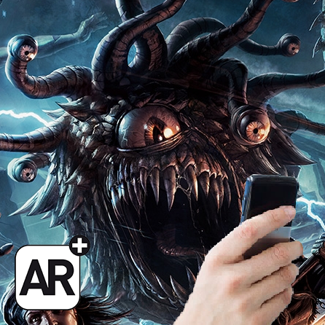
Augmented Roleplay
See your adventures as you always imagined them

Slide 2
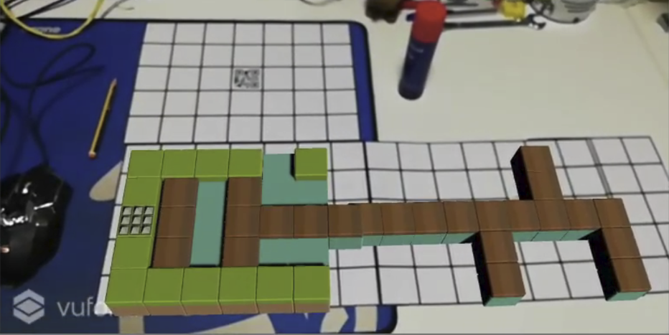
Our Proposal
Solution: Theater built through AR cards and managed by a phone App.
Localized and Portable
Customizable and Limitless
Fluid and Permanent
Augmented Reality 3D
Easy Interaction
Plan Ahead
Absolutely Free!

Slide 3
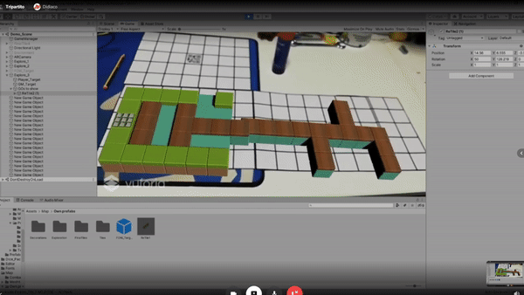
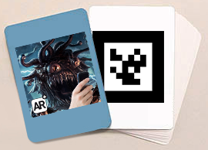
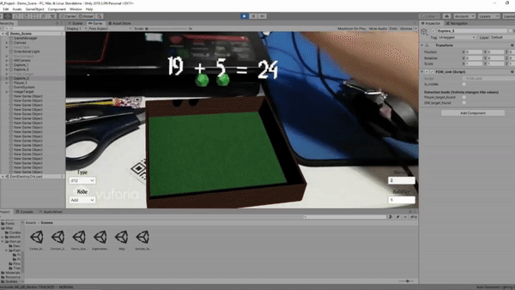
Localized and Portable
Your entire fantasy world inside your phone and a deck of cards/papers.

Slide 4
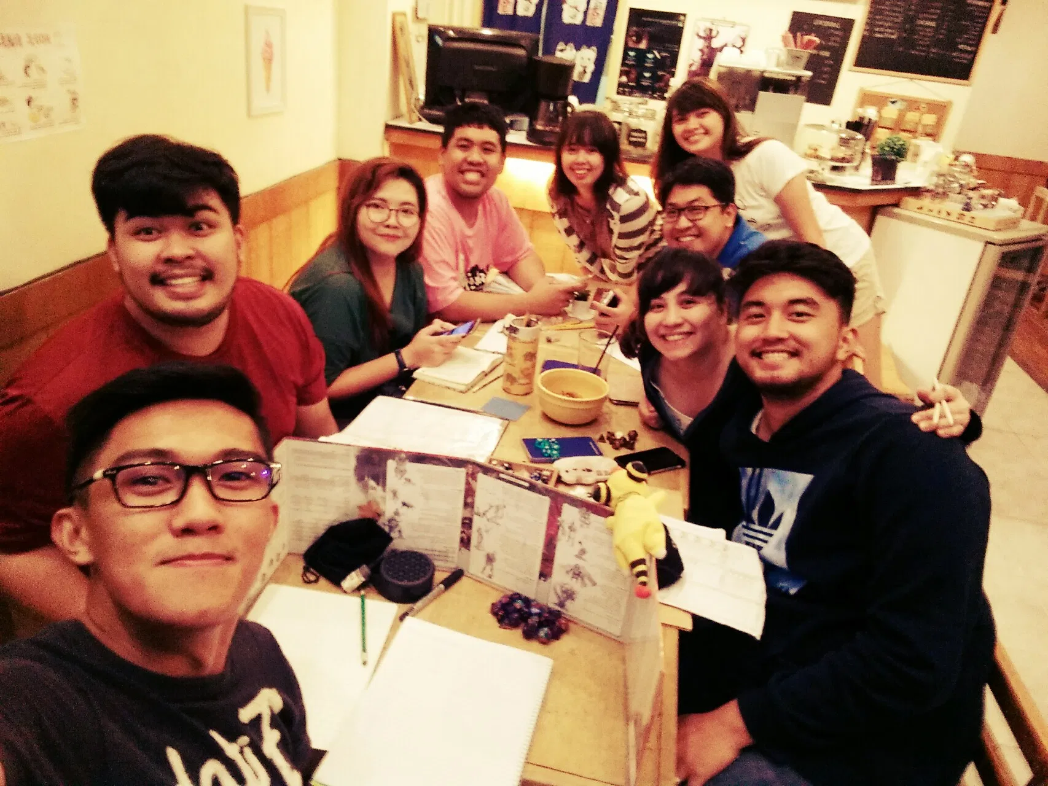
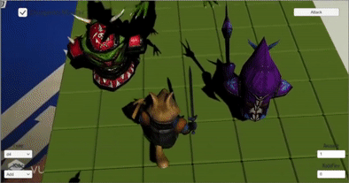
Augmented Reality 3D
Your worlds and characters in spectacular 3D filled with life, exactly how you envisioned them. All while playing in the same room with friends!

Slide 5
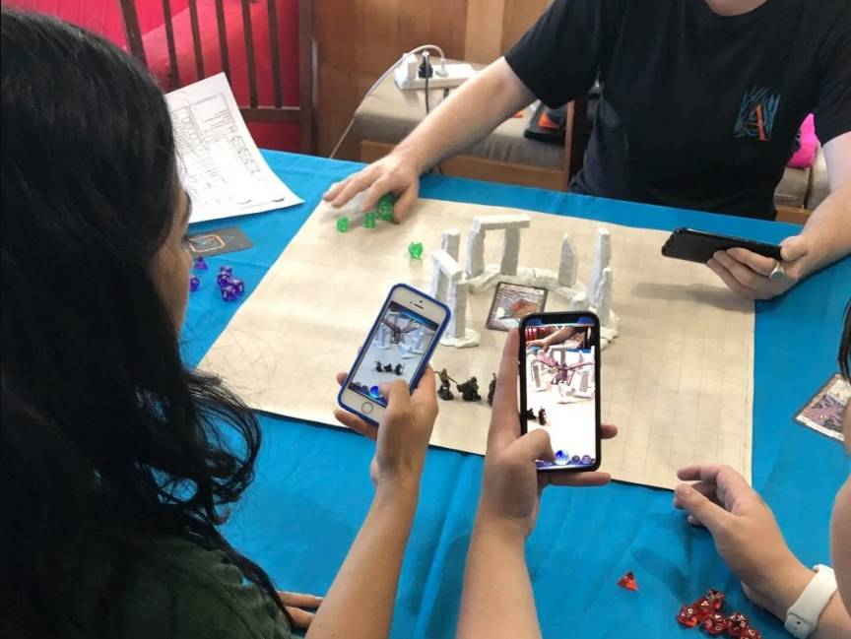
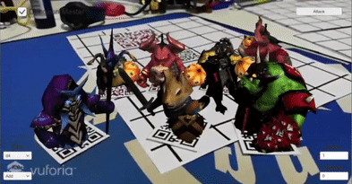
Easy Interaction
Manage your maps, characters, dice and NPCs live through your phone.

Slide 6
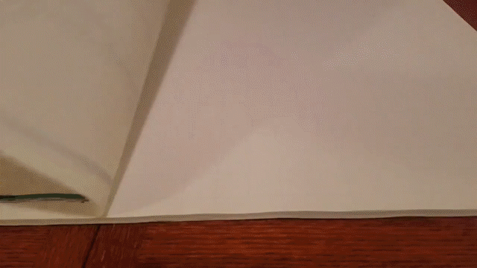
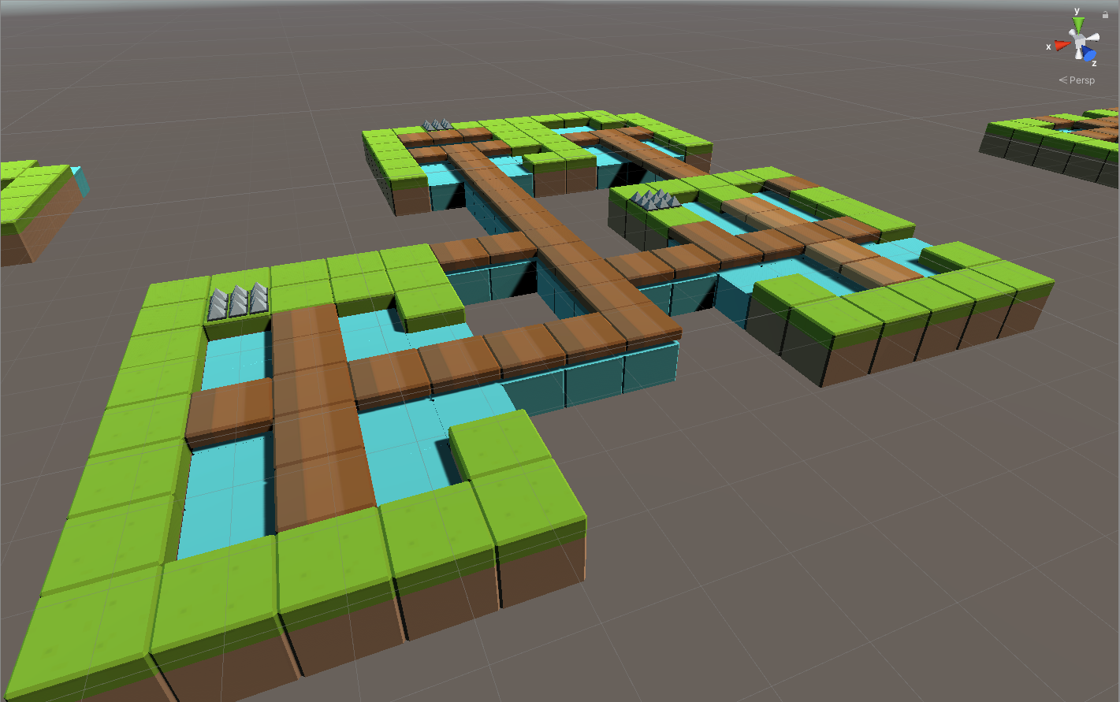

Plan Ahead
Get your session prepared long before it starts. Play as soon as possible!
Manually draw each one and either do it every time before you play or carry a bunch of giant maps around!
Import a map or create your own using assets, save it on your phone, then use or recycle it as many times you like!

Slide 7
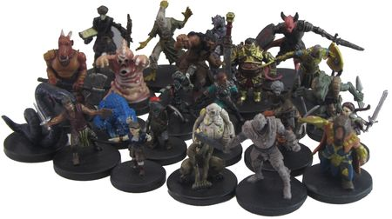
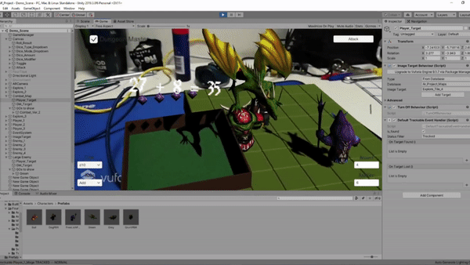
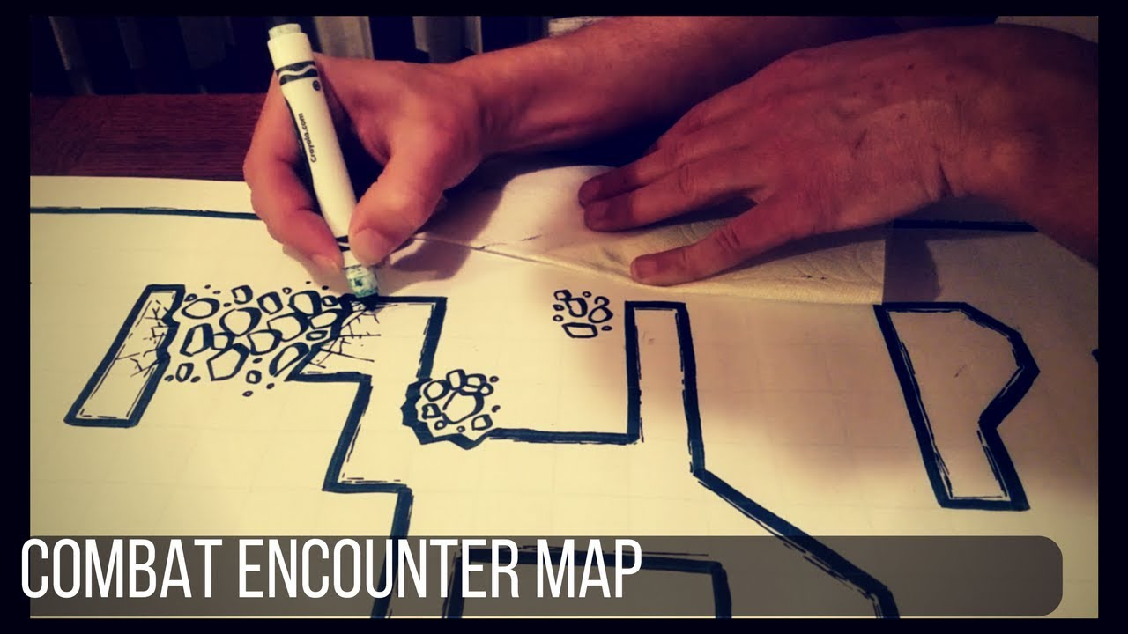
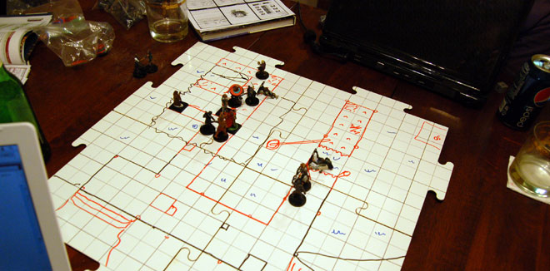
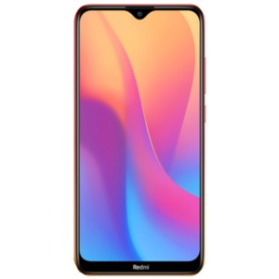


The World in your hand. Absolutely Free!
No more expensive miniatures, no more drawing on worn off Battle Mats, no more carrying a suitcase full of stuff! Just use your phone!

Slide 8
Showcase

Slide 9
The End

